Slide 2
Overview
2008 GFC: In response to the 2008 crisis, contingent convertible (CoCo) are introduced as a mechanism to strengthen bank stability by automatically converting debt into equity during financial distress.
March 19, 2023: The Swiss Financial Market Supervisory Authority (FINMA) announces the complete write-down of Credit Suisse's Additional Tier 1 (AT1) bonds, amounting to approximately CHF 16 billion.
Going forward: Dynamic Control of Leverage (DCL) introduced to prevent sudden drawdowns by only drawing down interest payments during times of high leverage, therefore gradually adjusting the balance sheet.
My task is to analyse DCLs in real world scenarios.

Slide 3
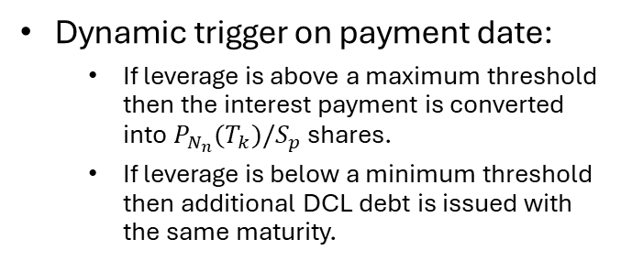

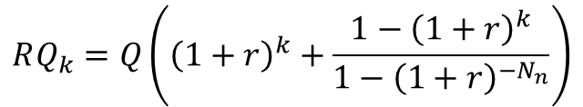
Dynamic Control of Leverage (DCL)
$$P_{N_{n}}\left(T_{i}\right)=\frac{rQ}{1−{\left(1+r\right)}^{−N_{n}}}$$
$$RQ_{k}=Q\left({\left(1+r\right)}^{k}+\frac{1−{\left(1+r\right)}^{k}}{1−{\left(1+r\right)}^{−N_{n}}}\right)$$
$$L_{k}=\frac{Total debt}{Total debt+Total equity}=\frac{RQ_{k}}{RQ_{k}+α_{k}∗NS_{k−1}∗S_{k}}$$
Dynamic trigger on payment date:
If leverage is above a maximum threshold then the interest payment is converted into $P_{N_{n}}(T_{k})/S_{p}$ shares.
If leverage is below a minimum threshold then additional DCL debt is issued with the same maturity.

Slide 4
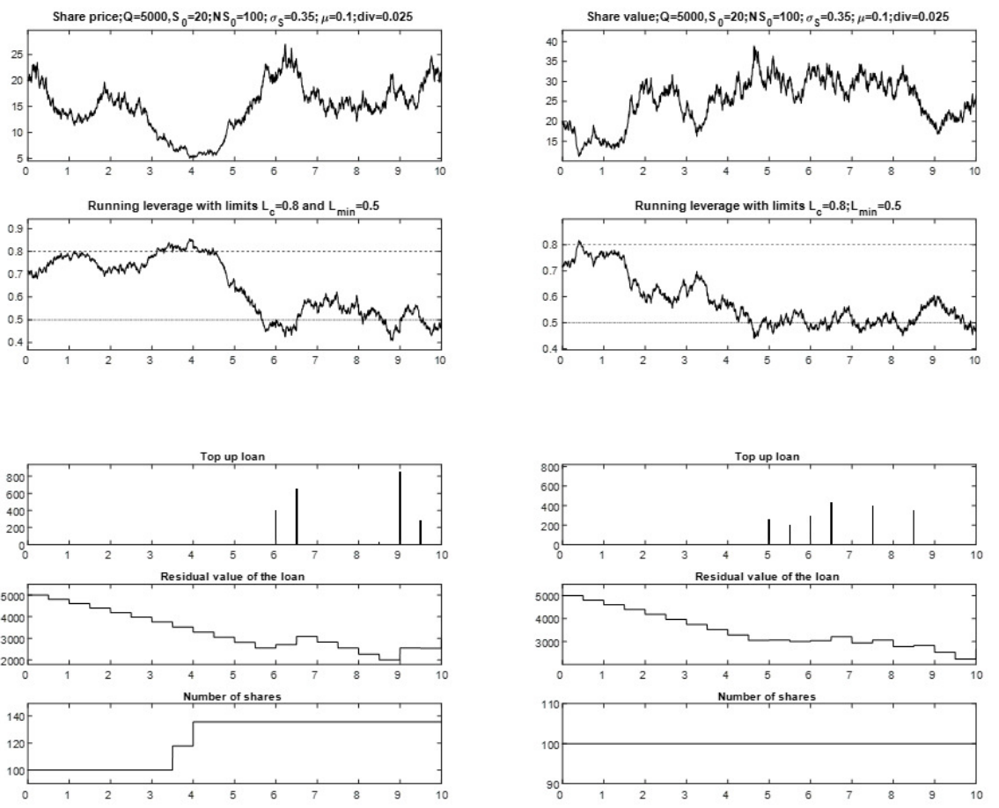
Theoretical Case Study

Slide 5
Real world simulations & Research questions
How would DCL bonds behave in the real world scenarios?
Would DCL have saved Credit Suisse?
What effect would DCL have for banks in the real world?
How do DCL parameters affect the outcomes?
Leverage triggers (minimum and maximum)
Frequency of payments and adjustments
Conversion price

Slide 6
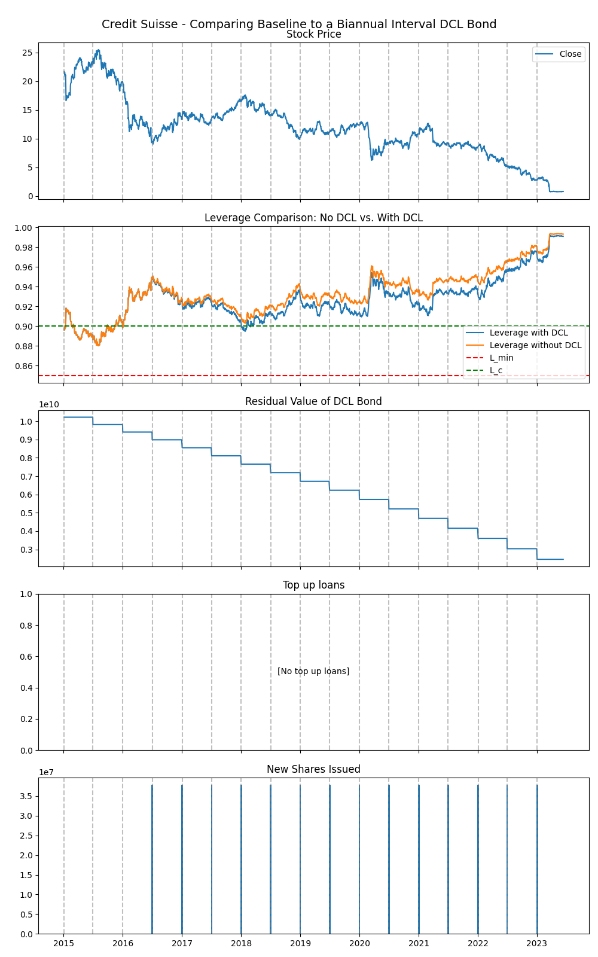
Simulating DCL bonds
Baseline model parameters:
Biannual payment and adjustments
Conversion price set the initial share price
Initial nominal value set to equal historical AT1 debt at issuance.
Maximum leverage at 95%
Minimum leverage at 85%
Results from simulation:
High leverage
No minimum trigger breaches
Early and frequent upper trigger breaches

Slide 7
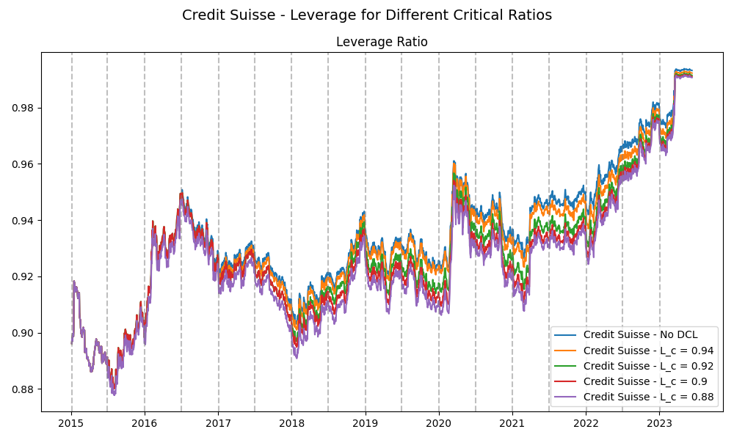

Slide 8
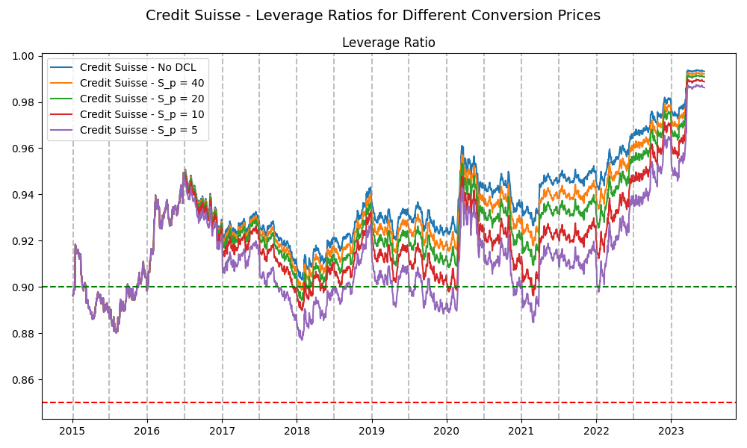

Slide 9
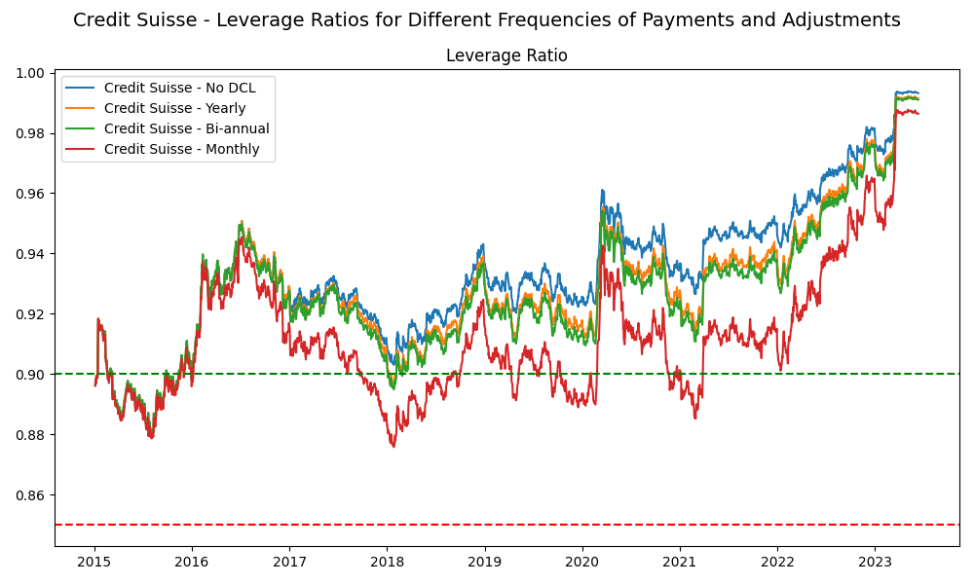

Slide 10
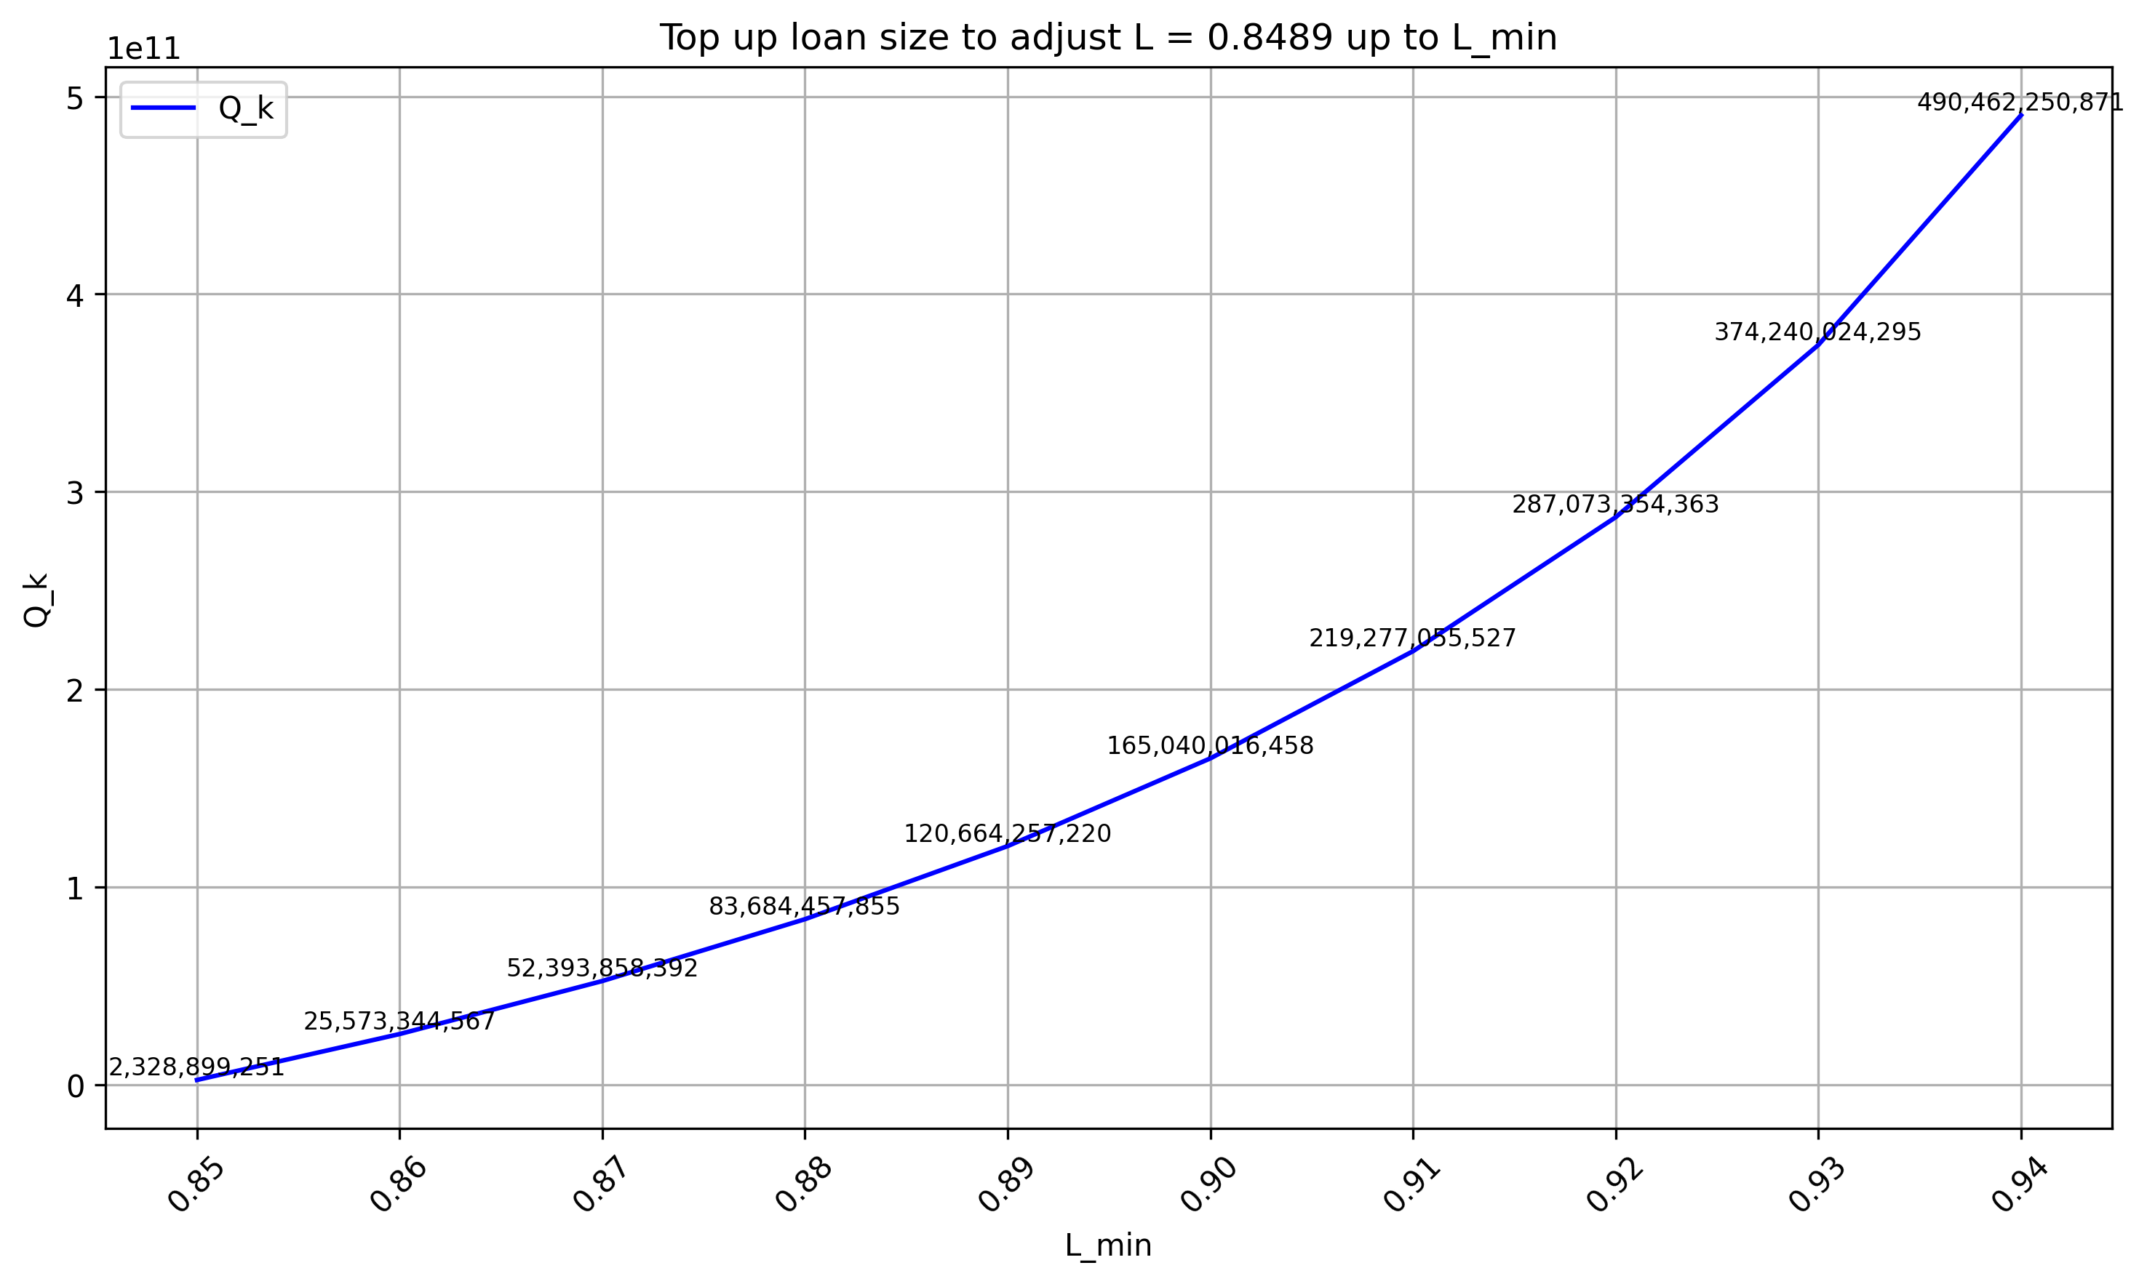
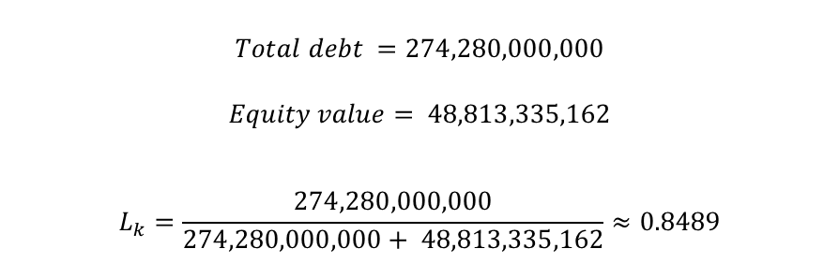
Minimum trigger breaches for highly levered companies
$$Total debt =274,280,000,000$$
$$Equity value= 48,813,335,162$$
$$L_{k}=\frac{274,280,000,000}{274,280,000,000+ 48,813,335,162}≈0.8489$$

